Slide 1


Drone Based Mapping and Ground Based Robotic Precision Spray System for Field Crops

Slide 2
Team Roles (Sprint 5)
Logan Sutton
Frontend & Backend structure and integrations
Path generation and storage
UI functionality
CI unit test workflow
Gil Rezin
Field map integration
Clustering conversion into polygons

Slide 3
Sprint 5 Objectives/Goals
API and Testing
Establish a CI workflow on github for automated testing
Unit tests for backend endpoints and services
Integration of Prescription Generation
Allow R script to be called by python backend
Produce shapefile output file that can be used by backend
Shapefile contains polygons with metadata for use by Amiga robot
Endpoints for prescription

Slide 4
Sprint 5 Objectives/Goals & Overall vision
Path finding module
Robot must autonomously traverse field
We can’t spray the field if we can’t traverse it
Prescription module
Must be called from the backend & uploaded to robot
Robot must be able to autonomously spray the field
While the robot is traversing it’s path, we read the prescription map
Spray based on where we are on the path
Linking and testing everything
We can run a workflow from start to finish
Prescription and pathing modules are integrated
Unit test coverage of backend

Slide 5
Feature Implementation (Logan)
Pathing algorithm using Fields2Cover (Python)
Generations a snake-pattern path based on a shapefile boundary
Can specify path width and headlands
Supports obstacles in field
Must be defined by the field boundary
Generated path converted to Farmng amiga waypoints
Waypoints stored in json format for Amiga
Displayable on the UI
UI has pathing visualization
Specify robot width, swath width, preview path on map
Unit tests for backend (88 currently)
Cover endpoints and basic service functionality (nothing heavy computation)

Slide 6
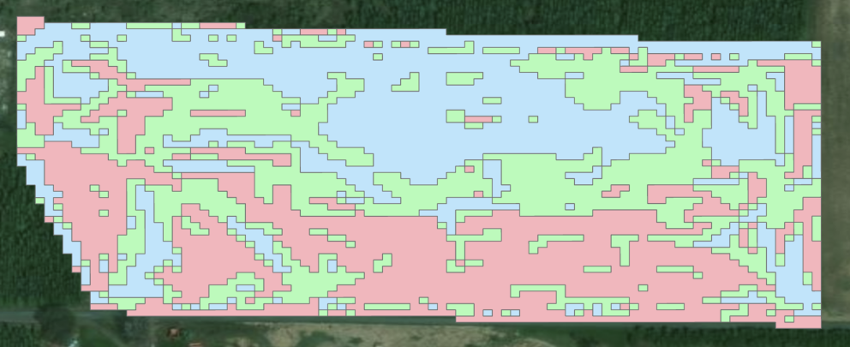

Feature Implementation (Gil)
Prescription module improvements
All cells of equivalent cluster placed into same polygon
Boundary of field now defined with farmer-specified shapefile
Module integration with backend
Added command-line parameters, can now be called from Command Prompt without needing a wrapper class
Module called using subprocess.run within Python

Slide 7
Demo

Slide 8
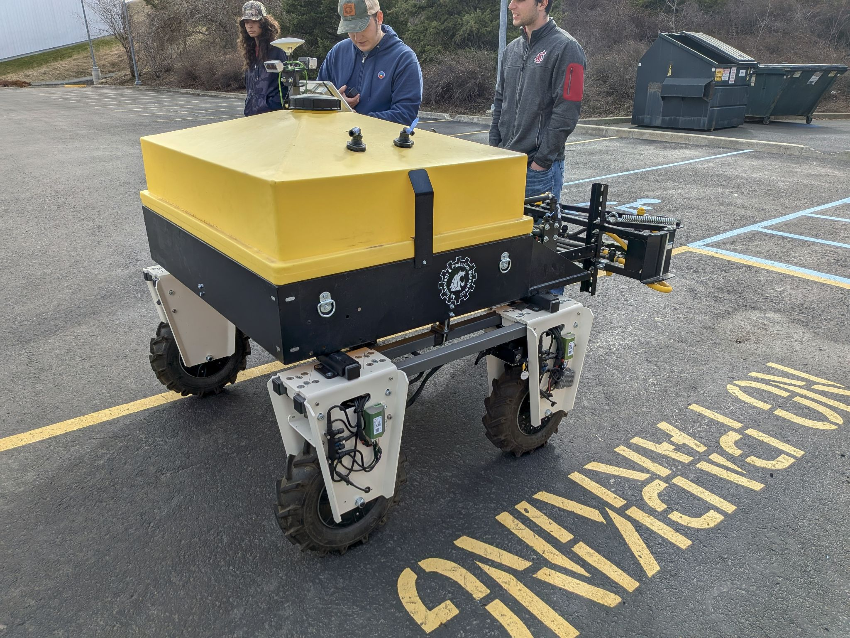
Testing
Path testing with robot in parking lot
Ran into RTK hardware issues
To be addressed in future testing
Prescription testing
Additional field data provided by Andrew
Recently sprayed field
Larger, non-rectangular fields
Unit testing
Unit tests for each module, some already started/implemented
End-to-end testing TBD

Slide 9
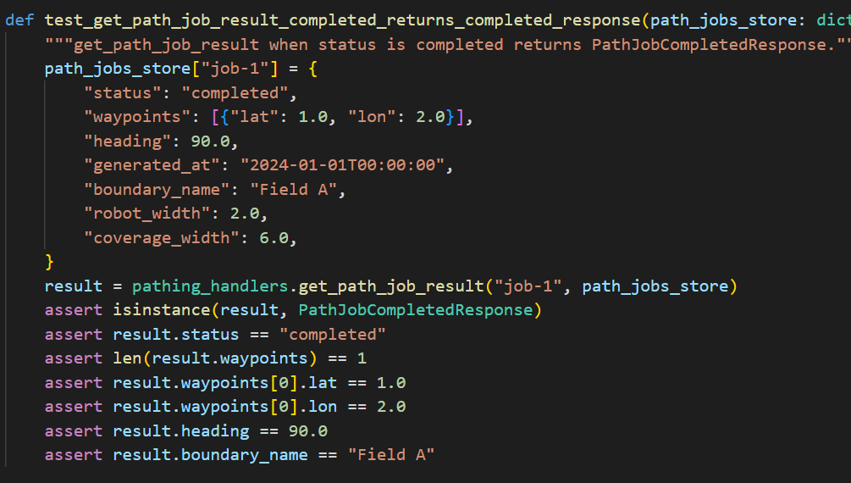
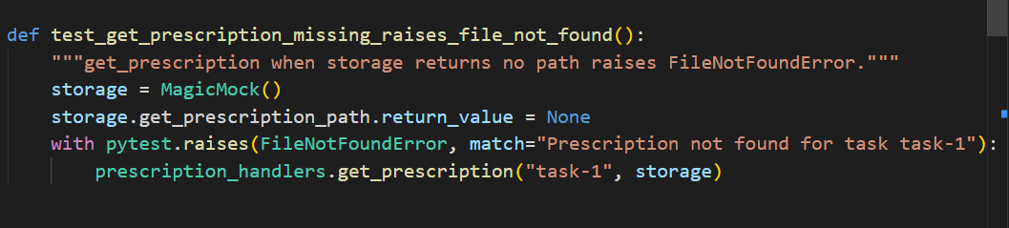
Unit testing
88 current unit tests
Cover typical, edge, and bad flow
Utilizing mocks for some test
I.e. file storage

Slide 10
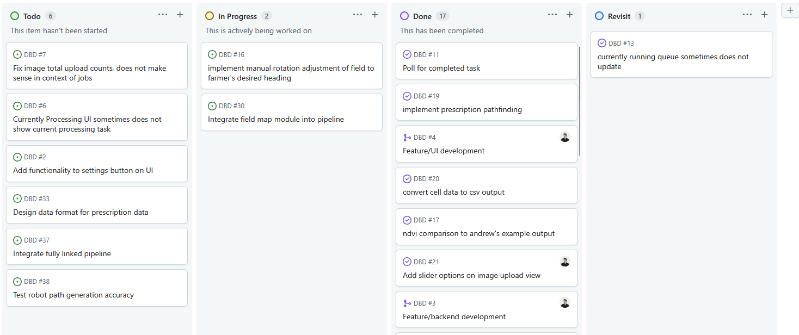
Kanban Board
[INSERT KANBAN BOARD IMAGE HERE]

Slide 11
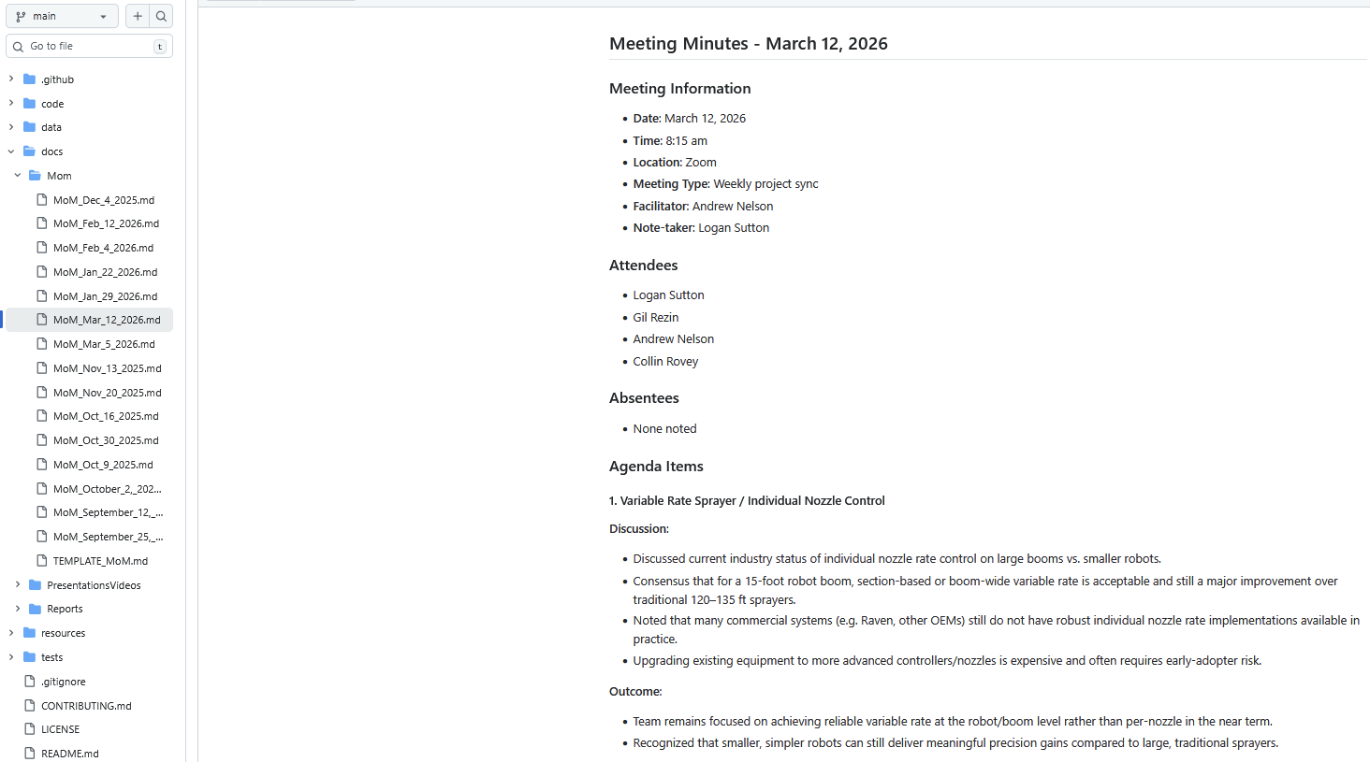
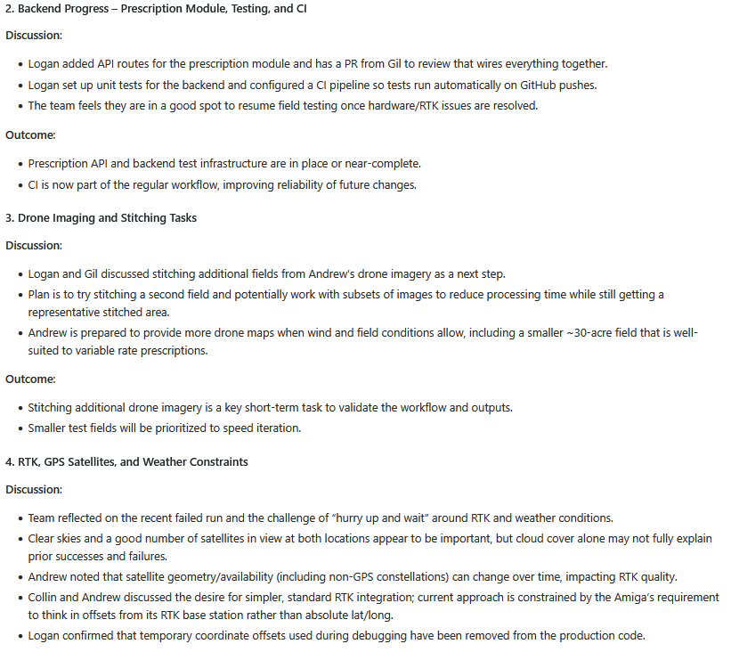
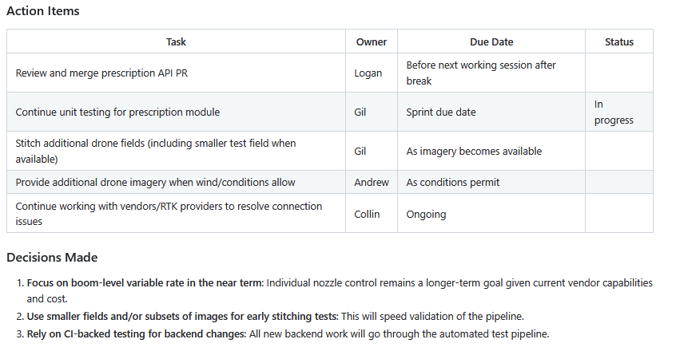

Slide 12
Overview of Report Changes
Add info about field2cover and pathing module
Add info about prescription integration
Talk current tests
Existing and future unit
Existing Integration
Functional
Refactor info on how prescription module works
Adjust requirements
Vertex maximum for prescription polygons

Slide 13
Gen AI usage
Frontend creation and modifications
Entirety of frontend has been built this way, per client request
Utilized Cursor IDE
Backend refactoring
Brainstorm ideas on how to reimplement
“Rewrite this code to output y instead of x”
Writing unit tests
Provide a specific section of code to unit test
Does decently well, can’t give to big of task
Assistance with debugging errors
Code cleanup

Slide 14
Improvement from Sprint 4
Path finding is done and integrated
Proved to be a difficult task for Sprint 2 and Sprint 3
Completed with Fields2Cover library
Integrated with frontend
Just needs testing (looks like it works initially)
Prescription module nearly integrated with system
All points setup for connection
Unit tests coverage for backend
API endpoints
Non-heavy services
Bad data handling
Application is now dockerized (dockerfile set up)

Slide 15
Achievements and Challenges
Achievements
Our pipeline is done, just waiting on hardware team for integration
Unit tests implemented, more on the way
Dockerized application
Challenges
Usage on WSL remains a challenge
Problems with R on Linux
Testing difficulties in final weeks
Engineering team is struggling with Amiga robot hardware

Slide 16
Next steps
Continue testing each module with unit and integration tests
Test pathing module with full test in parking lot
Test UI with Jest
Ensure we can upload files to Amiga
Engineering team resolves hardware issues

Slide 17
Thank you!
We’re excited to complete the system by Sprint 6!

